Slide 1

Digital Supply Chain Overview
Dr. Dale S. Rogers
ON Semiconductor Professor of Business
July 25, 2019
text can go here

Slide 2
Digital Supply Chain Management
Digital Supply Chain Management comprises the use of advanced systems, tools, workflows and analytics to plan, manage, and control transactions, data and information flows in structured, autonomous processes supporting the flow of physical, informational and financial resources across organizations, supplier, buyers, markets and consumers.

Slide 3
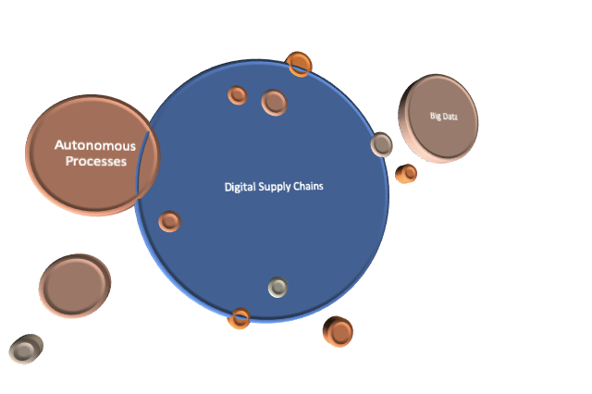
Digital Supply Chain

Slide 4
Intel Digitalization of the Supply Chain
Contract Analytics
Sourcing intelligence
Digital procurement
Autonomous planning
Supply chain virtual modeling
Self-serve inventory models
Cognitive forecasting / inventory
Capital supply chain optimization
Construction supply chain optimization
Indirect supply chain optimization
Spend Analytics
Supply chain risk and controls
Supplier quality machine learning
IoT enabled supply chain love just
Smart contracts with blockchain
E2E supply chain predictive visualization

Slide 5
Digital Supply Chain Technologies
3D printing/4D printing
Augmented Reality/Virtual Reality
Autonomous vehicles
Big data
Blockchain
Cognitive Computing/AI/Machine Learning
Control tower
Cybersecurity
Drones
Internet edge
IoT
Robots
RPA – robotic process automation
Supply Chain Mapping & Resiliency
Warehouse of the Future

Slide 6
Big Data

Slide 7
Big Data
Big data is a term that describes the large volume of structured and unstructured data that inundates a business on a day-to-day basis.
It is not the amount of data that’s important but instead what organizations do with the data that matters.
Can be analyzed for insights utilizing new technologies such as cognitive computing and other modeling techniques.

Slide 8
Big Data;
U.S. is higher than Brazil in:
Satisfaction with data availability
Satisfaction with data usability
Importance of big data in the supply chain over the next 3 years
Big Data maturity in their organization
How often the firm shares big data across projects
How often the firm shares big data across functions
How often the firm shares big data across organizations
Use of predictive analytics in decision-making
Software/hardware investment as impediment to big data implementation
Integration with siloed systems as impediment to big data implementation
Difficulty of using analytical tools as impediment to big data implementation
Acquisition of necessary talent/expertise as impediment to big data implementation
Level of managerial support and commitment as impediment to big data implementation
Over the next 12 months, importance of improving data accessibility
Over the next 12 months, investment in descriptive analytics
Over the next 12 months, investment in diagnostic analytics

Slide 9
Big Data:
Brazil is higher than the US:
Importance of big data in the supply chain over the next 3 years
Use of excel
Quality and integrity of data as an obstacle to big data implementation
Difficulty breaking through organizational silos as an obstacle to big data implementation
Difficulty determining the right source of data as an obstacle to big data implementation
Difficulty with timeliness and availability of data as an obstacle to big data implementation
Big data benefits on visibility of total cost to serve
Big data benefits on customer service
Big data benefits on demand planning
Big data benefits on risk and resiliency management
Big data benefits on end-to-end collaboration
Expected benefits from big data over the next 12 months in: profitability
Expected benefits from big data over the next 12 months in: inventory management
Expected benefits from big data over the next 12 months in: visibility in total-cost-to-serve
Expected benefits from big data over the next 12 months in: customer service
Expected benefits from big data over the next 12 months in: demand planning
Expected benefits from big data over the next 12 months in: risk and resilience management
Expected benefits from big data over the next 12 months in: supply chain visibility
Expected benefits from big data over the next 12 months in: end to end collaboration

Slide 10
Big Data Bottom Line;
Brazil vs. U.S.
Essentially US firms are reporting more obstacles, and more plans for future investments.
Brazilians are much more optimistic – mainly reporting realized and expected benefits.

Slide 11
3D Printing/4D Printing

Slide 13
Augmented Reality/
Virtual Reality

Slide 14
Augmented Reality/Virtual Reality

Slide 15
Blockchain

Slide 16
Where will Blockchain be applied/Not Applied?
“Sweet Spot”
High value items
High visibility requirements
Clear chain of custody
High information requirement products
High likelihood of supply disruptions
Supply network does not have adequate systems
Low trust environment
Less Likely Applications
Low value items
Visibility unnecessary
2nd or 3rd tier suppliers do not need to be managed
Stable product
Supply network generally stable
Supply Chain systems perceived as adequate
High trust environment

Slide 17
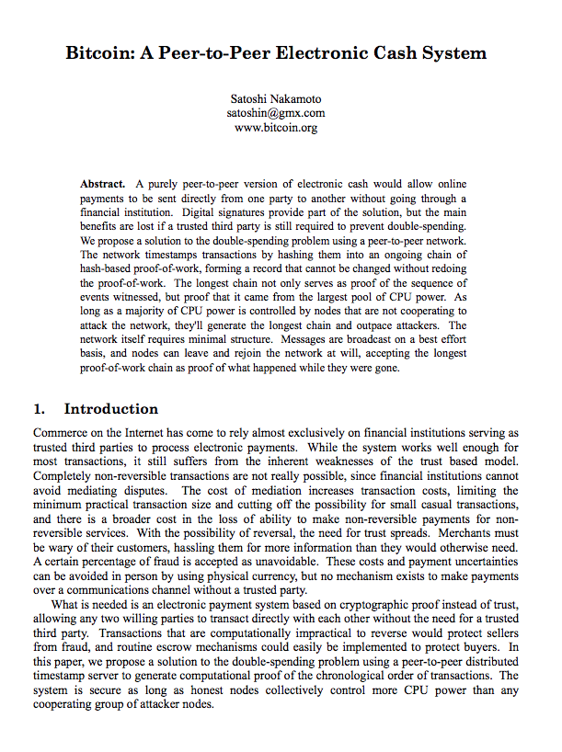
Satoshi Nakamoto

Slide 18
Excitement about Blockchain
Cracking the Byzantine General’s Problem
Connecting Distributed Computers
Single Source of Truth
Blockchains will be a “business transparency tool”
Unnecessary intermediaries may be eliminated.
Investment Frenzy

Slide 19
So, What is Blockchain?
Distributed Computing & Ledgers
Digital Currency or Tokens
Consensus Validation & Cryptographic Security
Smart Contract Code & Chain Code for Workflow Automation

Slide 20
Cognitive Computing

Slide 21
Machine Learning, Artificial Intelligence and Cognitive Computing
Cognitive Computing
Artificial Intelligence
Machine Learning

Slide 22
Machine Learning, Artificial Intelligence and Cognitive Computing
Machine Learning
  Provides computers with the ability to continuing learning without being pre-programmed after a manual.
  Machine Learning is algorithms that learn from data and create foresights based on this data.
  A simple example of how it can be used: Building a model, that can predict customer demand by understanding the correlation between sales numbers from a store correlated with historical weather data and local events happening in the area.
Artificial Intelligence
  Machines work “intelligently”.
  The intelligence emerges from a business point of view when machines – based on information – are able to make decisions, which maximizes the chances of success in a given topic.
  By the use of Machine Learning, Artificial Intelligence is able to use learning from a data set to solve problems and give relevant recommendations. If we continue the example from above, we can use the learning about the correlation between weather, local events and sales numbers to create a fully automated system, that decides upon the daily supply shipped to a given store.
Cognitive Computing
  Systems that learn at scale, reason with purpose and interact with humans naturally.
  Mixture of computer science and cognitive science – that is, the understanding of the human brain and how it works.
  By means of self-teaching algorithms that use data mining, visual recognition, and natural language processing, the computer is able to solve problems and thereby optimize human processes.

Slide 23
Machine Learning Methodologies
Methodologies
High Dimensional Model Representation (HDMR)
Representational Learning
Support Vector Machine (SVM)
Random Forest
Gradient Boost
Bayesian Network (BN)
Neural Network (NN)
Clustering

Slide 24
Cognitive Computing- continued
Cognitive systems are probabilistic, meaning they are designed to adapt and make sense of the complexity and unpredictability of unstructured information.
They can “read” text, “see” images and “hear” natural speech.
They interpret that information, organize it and offer explanations of what it means, along with the rationale for their conclusions.

Slide 25
What is Cognitive Procurement and its Applications?
When cognitive computing is applied to procurement solutions, the result is cognitive procurement, a process in which computers use data mining, pattern recognition, and natural language process (NLP) to mimic human activity concerning procurement processes.
This cuts down on a great deal of manual work that would otherwise be required, cutting costs for your procurement team while also making it more efficient.

Slide 26
Control Tower

Slide 27
Control Tower
Supply Chain Control Tower software orchestrates orders and processes across global locations, streamlining inbound, outbound, domestic, and international orders, giving you inventory visibility with integration across operational systems.
Control tower generally include dashboarding capabilities.

Slide 28
Cybersecurity

Slide 29
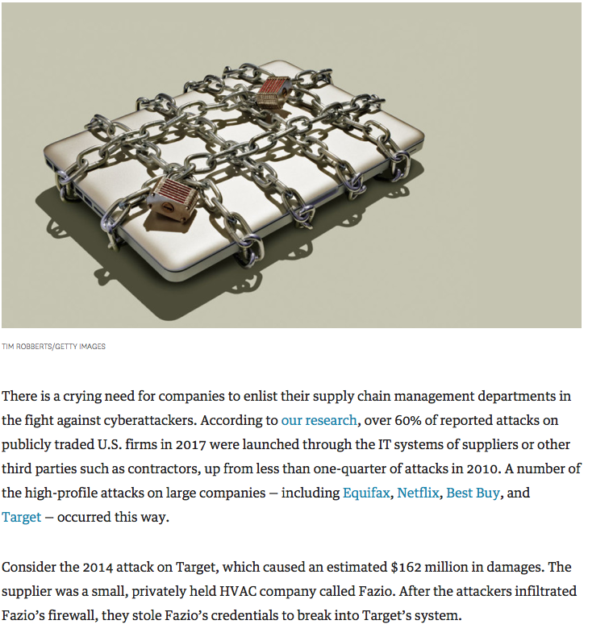
Cybersecurity
“Over 60% of reported attacks on publicly traded U.S. firms in 2017 were launched through the IT systems of suppliers or other third parties such as contractors, up from less than one-quarter of attacks in 2010.”
Source: Zac Rogers and Tom Choi, JULY 10, 2018. Purchasing Managers Have a Lead Role to Play in Cyber Defense. Harvard Business Review, https://hbr.org/2018/07/purchasing-managers-have-a-lead-role-to-play-in-cyber-defense

Slide 30
Drones

Slide 31
Drones

Slide 32
Internet edge

Slide 33
Internet edge
Internet edge is the movement of computing from centralized servers to more distributed computing at the intersection of where the Internet meets people and businesses.
http://internetedgelab.com

Slide 34
Internet of Things
IoT

Slide 35
IoT
IoT is the linking of computing devices embedded in everyday objects, enabling them to send and receive data.
Example: Volteo

Slide 36
Robots & Robotic Process Automation

Slide 37
Robots

Slide 38
Locus Robotics and Fetch Robotics Solutions

Slide 39
Autonomously Guided Vehicles (AGVs)
AGVs use radar, LIDAR, camera scanning, and ultrasonic and infrared sensors to route themselves without predefined paths.
AGVs create maps within their own databases and are continuously updating them because they are aware of their changing surroundings.
Similar to self-driving cars that have begun to appear on the road.
Can appear on-demand, adapt to changing directions, and adapt to barriers or obstacles.
Allows for flexibility and quick deployment without the need for significant changes in infrastructure inside distribution centers

Slide 40
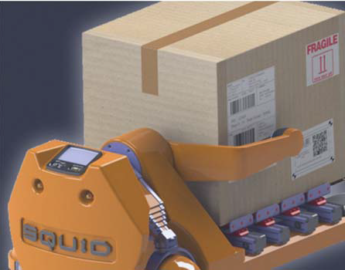
Vertical, Full Case Picking Applications
Bionic Hive’s autonomous picking unit

Slide 41
Robotic process automation (RPA) is the application of technology that allows people to configure computer software or a “robot” to capture and interpret existing applications for processing a transaction, manipulating data, triggering responses and communicating with other digital systems.
Web scraping

Slide 42
Supply Chain Mapping & Resiliency

Slide 43
Mapping, Resiliency and Continuity
Event Management, Risk Management, Supply Network Management
Resilinc
Elementum

Slide 44
Warehouse of the Future

Slide 45
Warehouse of the Future
The warehouse of the future is not just a stocking space, but a value center where light manufacturing, conversion, 3-d printing, etc. may occur to provide that ‘last-mile’ personalization that the traditional manufacturers and retailers models cannot provide due to their long cycle/lead time.

Slide 46
Warehouse Systems
WMS
WCS
WES

Slide 47
Portfolio of Warehouse Types
Traditional, large warehouse
Contract
Pop-Up
Customer facing
Flow Warehouses
Pop-Up Warehouses
On-Demand Warehousing
High Ceiling Warehouses
Central Return Centers
Futuristic Facilities

